Slide 1
Jade’s Self-Service Machine (JSSM)
People in small food stalls or cafeterias often struggle with keeping track of orders and total prices, especially without a point-of-sale system. This Python program i made has a solution that helps automate it.

Slide 2

Why you ask?
Because people in small food stalls or cafeterias often struggle with keeping track of orders and total prices, especially without a point-of-sale system. This Python program i made has a solution that helps automate it.

Slide 3

This is a Simple Food Ordering System with a Ticket Number
A command-line array-based food ordering system that lets customers select menu items, specify quantity, and receive an order receipt with a unique ticket number.

Slide 4
(Inputs & Outputs)
Input: Item number from the menu, quantity, commands like 'v' to view 'f' to finish and 'q' to quit.
Output: List of ordered items, total cost, and your own ticket number

Slide 5
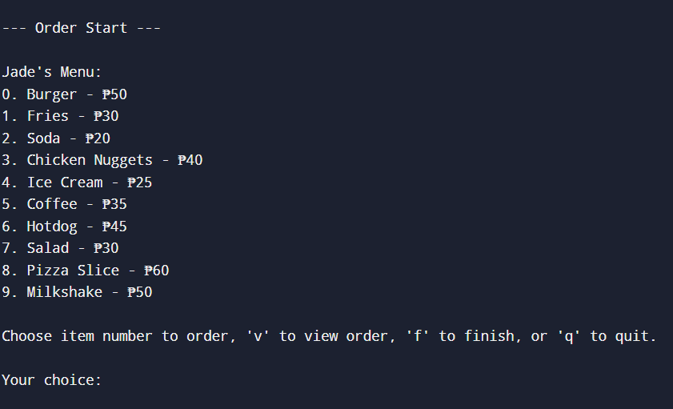
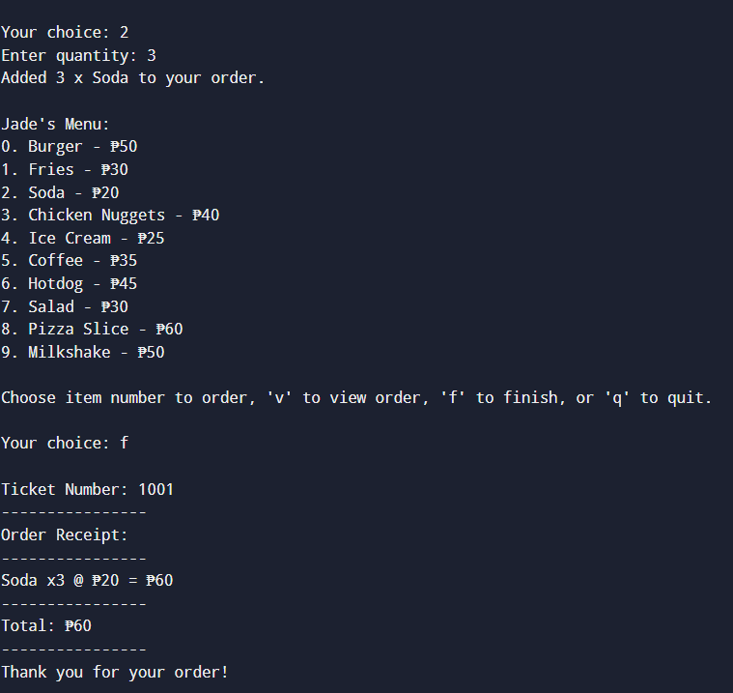
EXAMPLE
INPUT
OUTPUT

Slide 6

WHY IS IT USEFUL?
It simplifies the ordering process, cause some people prefer to take their own order, especially introverted ones.

Slide 7
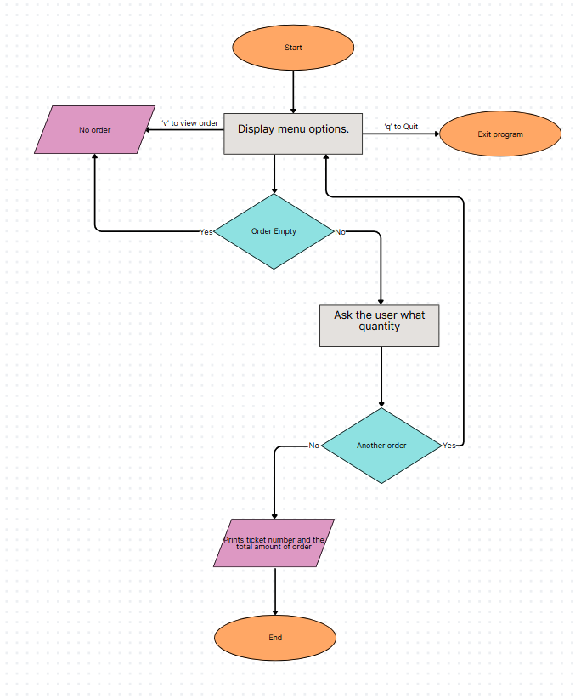
FLOWCHART

